Slide 1

TITLE: DELIVER ON TIME
Presented By:-
K. Harshitha- 160122737010
M. Shivani- 160122737012
Course: Information Technology H1
DATA ANALYSIS AND VISUALIZATION-22ADE01

Slide 2

ABSTRACT:
This project examines online delivery service dynamics via comprehensive data analysis. It entails understanding, cleaning, and exploring relationships within a dataset comprising delivery, weather, and personnel information. Through EDA and feature engineering, it uncovers insights into factors influencing delivery time, facilitating a deeper understanding of online delivery operations.

Slide 3

PROBLEM STATEMENT:
This project focuses on investigating the intricate dynamics of time within online food delivery services through comprehensive data analysis and visualization techniques. By delving into a rich dataset comprising various attributes such as delivery personnel details, weather conditions, and order specifics, the aim is to uncover underlying patterns and trends influencing delivery times. Through meticulous data exploration and visualization, the project seeks to reveal insights into factors impacting delivery efficiency and customer experience, ultimately aiming to optimize operations and enhance service quality in the online food delivery sector.

Slide 4

OBJECTIVES AND OUTCOMES:
Objective 1 (Bloom's Taxonomy Level 3 - Application):
Apply data analysis techniques to identify and address data quality issues in the online food delivery dataset.
Outcome 1:
Demonstrate proficiency in using Pandas to load the dataset, identify missing data, outliers, zero values, and duplicates, and apply appropriate methods to handle these issues effectively.
Objective 2 (Bloom's Taxonomy Level 4 - Analysis):
Analyse temporal patterns and trends in delivery times across different variables to gain insights into factors influencing service efficiency and customer satisfaction.
Outcome 2:
Utilize statistical methods and visualization techniques (e.g., scatter plots, line plots) to explore relationships between delivery times and variables such as day of the week, time of day, geographical location, and food type, thereby identifying key factors impacting delivery performance.

Slide 5

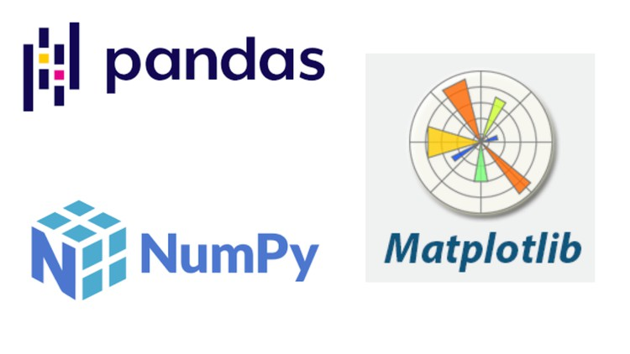


TECHNOLOGY STACK:
Python: As the primary programming language for data analysis tasks.
Pandas: For data manipulation and analysis, including loading the dataset, data preprocessing, and feature engineering.
NumPy: For numerical operations and array manipulation, often used in conjunction with Pandas for data processing.
Matplotlib and Seaborn: For data visualization, including plotting graphs and charts to explore relationships between variables and visualize model results.
GitHub: As an interactive development environment for running Python code, exploring data, and documenting the analysis process.
Google Colaboratory: a free cloud-based platform provided by Google that allows users to write and execute Python code collaboratively in a browser environment, with access to powerful computing resources including GPUs and TPUs.

Slide 6
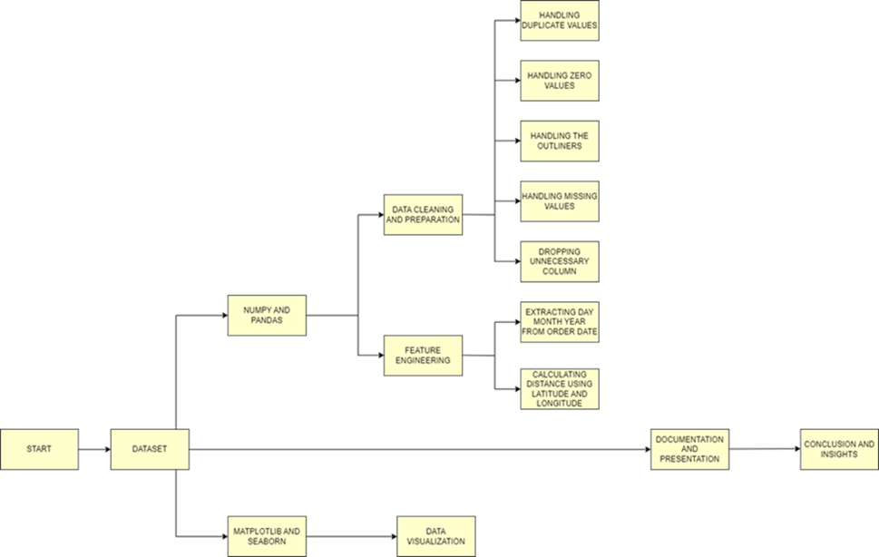
SYSTEM DIAGRAM/ DESIGN FLOW:
The data cleaning process ensures accuracy and reliability by systematically identifying and rectifying inconsistencies, missing values, duplicates, and outliers in the dataset. Through structured steps including column removal, missing value handling, duplicate removal, data type conversion, outlier detection, and zero value correction, the dataset is prepared for in-depth analysis. This meticulous cleaning lays the groundwork for uncovering insights into delivery time dynamics in online delivery services.

Slide 7
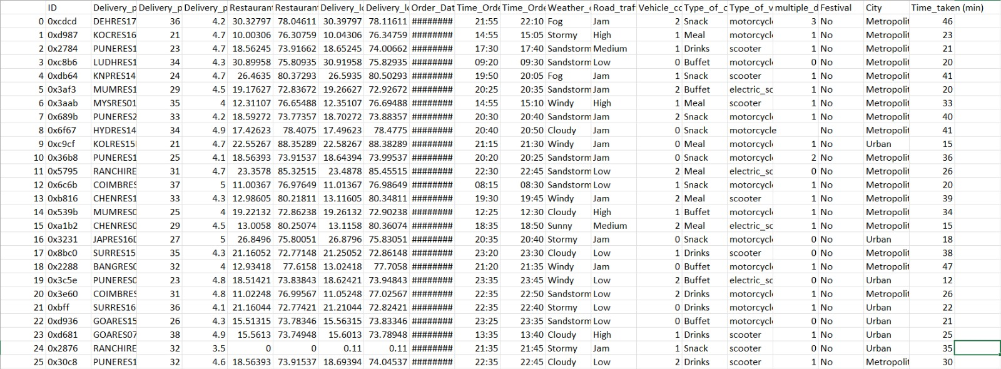
DATASET:
Dataset from the GitHub platform, which contains relevant information on online food delivery operations, including attributes such as delivery personnel details, weather conditions, and order characteristics. This dataset serves as the foundation for conducting thorough analysis and exploration of the time dynamics in online food delivery services.

Slide 8
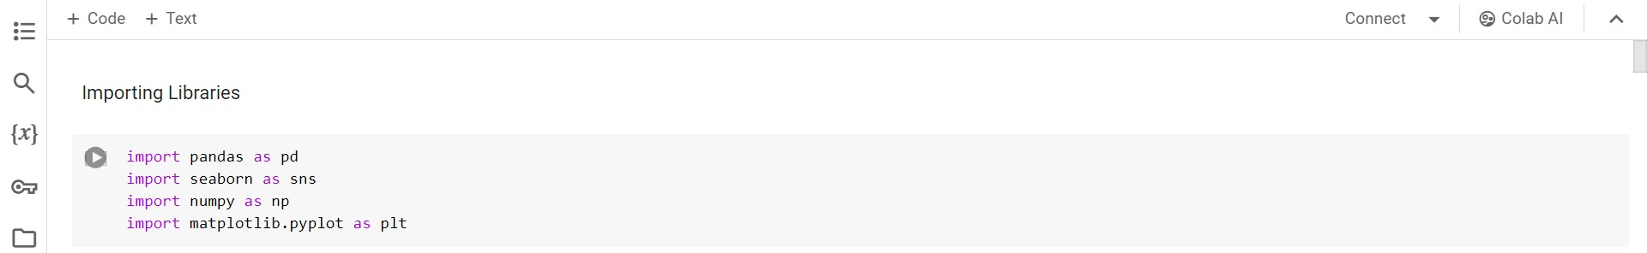
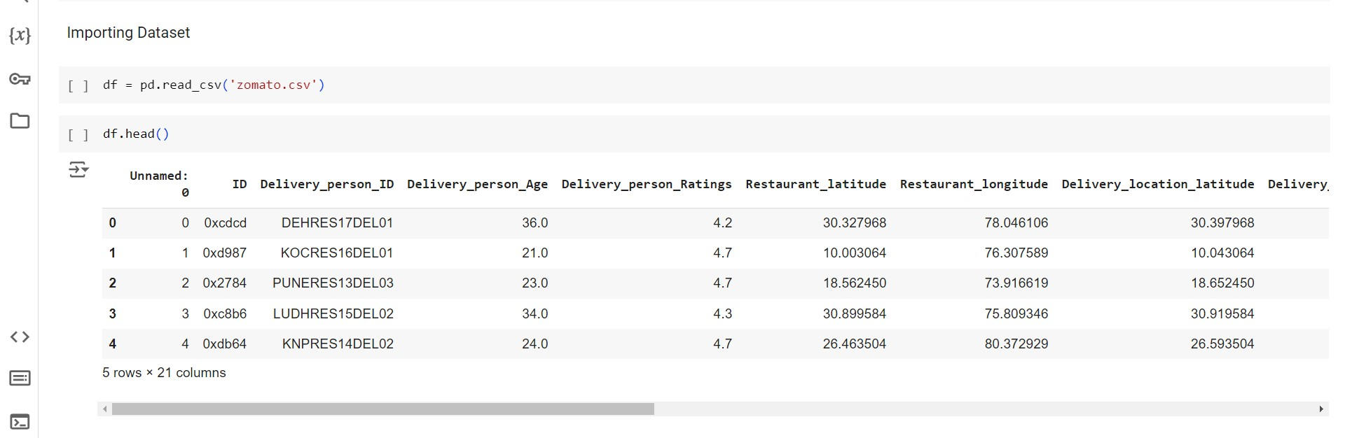
IMPLEMENTATION:

Slide 9
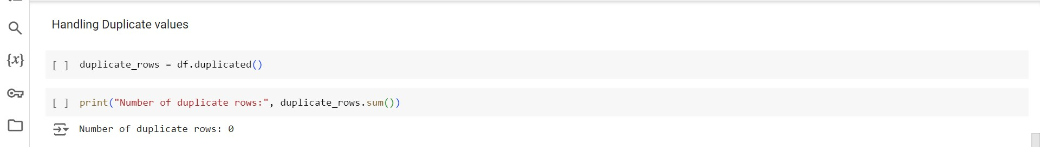
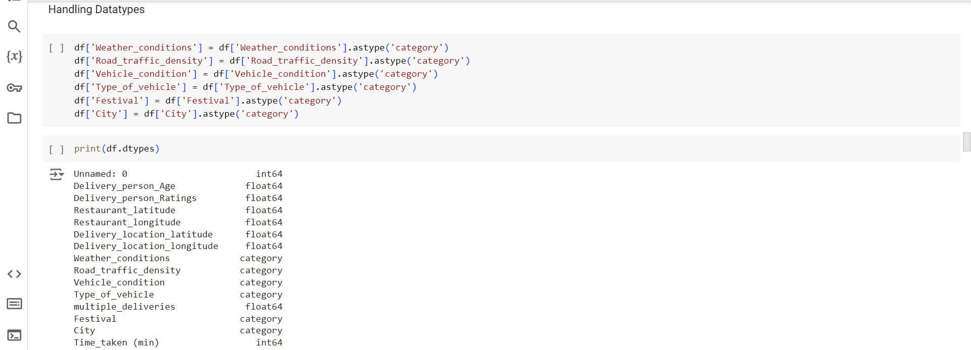
IMPLEMENTATION:

Slide 10
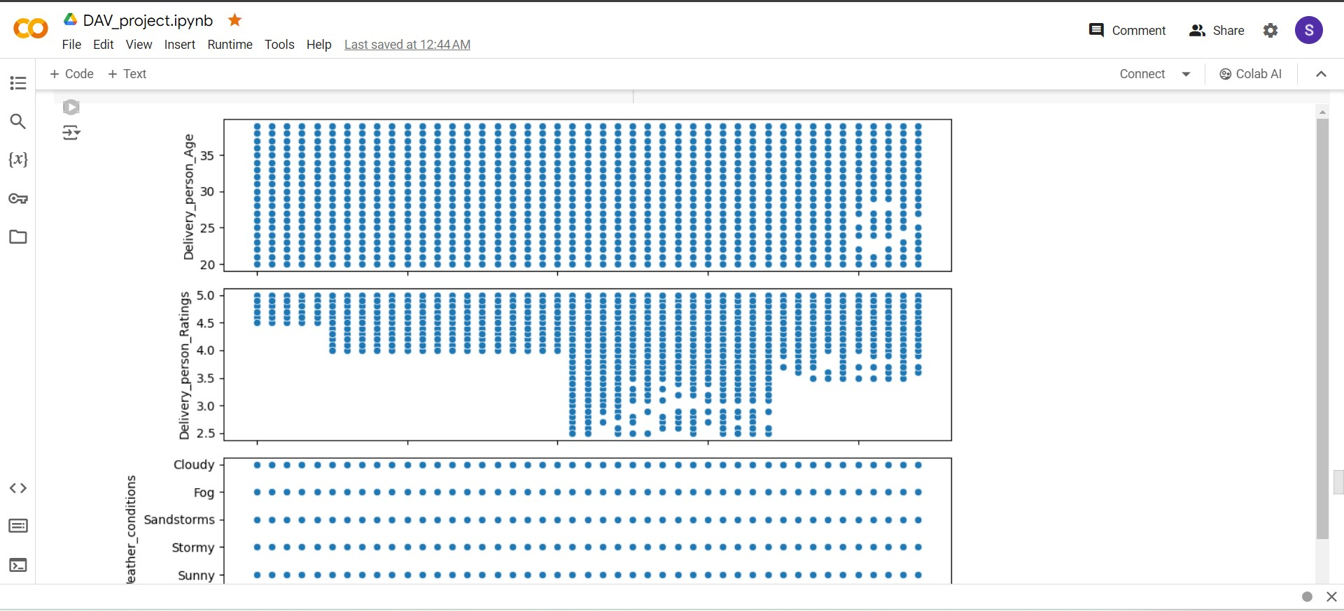
RESULT ANALYSIS:
Scatter plots visually examine the relationship between continuous variables like 'Delivery_person_Age' and 'Time_taken'. They provide insights into trends and patterns, while categorical attributes like 'Weather_conditions' are also included for comparison, despite scatter plots being less suited for categorical data. This aids in understanding relationships between variables, aiding hypothesis generation and feature selection for further analysis.

Slide 11
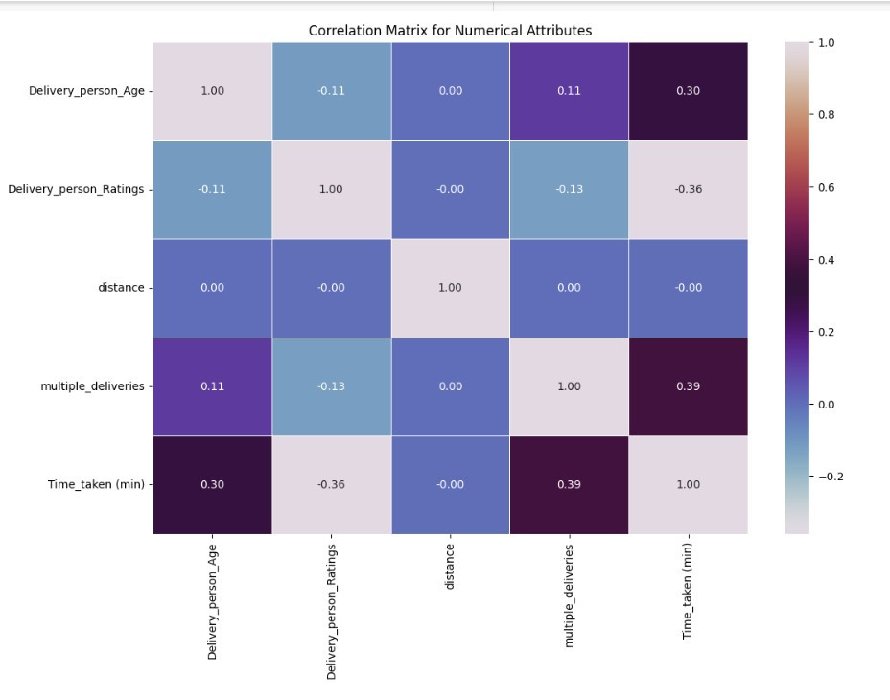
RESULT ANALYSIS:
A correlation matrix quantifies linear relationships between numerical variables like 'Delivery_person_Age' and 'Time_taken'. Visualized through a heatmap, it highlights strong correlations as high positive or negative coefficients. This tool helps identify multicollinearity issues and informs feature selection, enhancing predictive model interpretability and refinement.

Slide 12
CONCLUSION:
Based on the correlation matrix analysis, the conclusions emerge regarding the relationships between various attributes and delivery time:
Delivery Person Age: There exists a moderate positive correlation (+0.30) between the age of the delivery person and the time taken for delivery. This suggests that older delivery personnel may take slightly longer to complete deliveries compared to younger counterparts. Possible reasons could include differences in energy levels, efficiency, or familiarity with delivery routes.
Delivery Person Ratings: A moderate negative correlation (-0.36) is observed between delivery person ratings and delivery time. This implies that delivery personnel with higher ratings tend to complete deliveries more quickly than those with lower ratings. Higher ratings may indicate greater proficiency, reliability, and effectiveness in handling delivery tasks.
Multiple Deliveries: There is a moderate positive correlation (+0.39) between the number of multiple deliveries and delivery time. This suggests that when a delivery person handles multiple deliveries in a single trip, the overall delivery time tends to increase. This could be due to the added complexity and time required to navigate between multiple delivery locations efficiently.

Slide 13
INSIGHTS GAINED:
These findings provide valuable insights for optimizing online delivery services:
Optimizing Delivery Routes:
Understanding the impact of delivery person age and ratings on delivery time can help in optimizing delivery routes and assigning deliveries to personnel based on their characteristics. For instance, younger delivery personnel may be assigned to routes with shorter distances or higher demand areas, while those with higher ratings can handle time-sensitive orders.
Efficiency Improvement:
Strategies aimed at improving delivery efficiency, such as providing training or incentives to delivery personnel with lower ratings, or optimizing the allocation of multiple deliveries to minimize overall delivery time, can be implemented to enhance service quality and customer satisfaction.
Data-Driven Decision Making:
These insights underscore the importance of data-driven decision-making in online delivery services. By continuously analyzing and leveraging data on delivery operations, companies can identify areas for improvement, refine their strategies, and stay competitive in the rapidly evolving market landscape.

Slide 14
REFERENCES:
[1] On-Time Last-Mile Delivery: Order Assignment with Travel-Time PredictorsSheng Liu, Long He, Z. Shen ,2020, Management Sciences
[2] Data-driven optimization for last-mile deliveryHongrui Chu, Wensi Zhang, P. Bai, Yahong Chen,2021, Complex & Intelligent Systems
[3] Factor Analysis on Online Food Delivery Service in the New NormalAlexis M Bagot,Linette H Maalihan,Ma Nicole Pattalitan,Saira M Moro,Ginell Joseph De Roxas,Jen Ysabelle Bagui,Noelah Mae Dimayuga Borbon,2022,Asian pacific journel of Academic Research in Buisness Administration
[4] A review on delivery routing problem and its approachesS.N. Ismail, Ku Ruhana Ku-Mahamud ,Syariza Abdul Rahman,2017, Journal of Theoretical and Applied Information Technology
[5] Optimisation of takeaway delivery routes considering the mutual satisfactions of merchants and customers, Ren Teng , Xu Hong-bo , Jin Kang-ning , Luo Tian-yu , Wang Ling , Xing Li-ning ,2021, Computers & Industrial Engineering

